Slide 1
TALKING FINGERS
PIP2001 Capstone Project
Review-4
Batch Number: CSE G-111
Roll Number | Student Name
20211CSE0564 | Vihar Jyothi
20211CSE0566 | Rakshith S
20211CSE0569 | Anvith G
20211CSE0570 | Akash M K
20211CSE0574 | Vivek M
Under the Supervision of,
Dr. Joseph Michael Jerard V
Professor
School of Computer Science and Engineering
Presidency University
Name of the Program: CSE
Name of the HoD: Dr.Asif Mohammed H.B
Name of the Program Project Coordinator: Mr. Amarnath J.L

Slide 2
Introduction
Purpose:
Aimed at bridging the communication gap between hearing-impaired individuals and the rest of the world using text-to-sign language translation.
Core Functionality:
Converts text input into sign language gestures displayed through dynamic images for better understanding.
Technology Used:
Developed as an Android application utilizing Java, Glide library for image handling, and intuitive UI components.
Key Features:
Multi-language support (e.g., English, Hindi, Bengali).
Dynamic display of sign language gestures with horizontal scrolling for ease of navigation.
Speech-to-text integration for future scalability.
Social Impact:
Promotes inclusivity, accessibility, and equal communication opportunities for hearing-impaired individuals.

Slide 3
Literature Review
1. Overview of Existing Research
Studies in sign language translation focus on converting text or speech into visual representation using gesture recognition and NLP. Research highlights include advancements in deep learning models for accuracy in sign language interpretation.
2. Current Technologies
Existing tools mainly use gesture-based input with strengths in precision but limitations in hardware dependency, lack of multilingual support, and challenges with complex sentences.
3. Gaps in Research
Key gaps include limited support for multilingual speech, accuracy in text-to-sign conversion, and lack of integration with deep learning techniques for natural ISL grammar.

Slide 4
Continued…
4. Theoretical Foundations
The approach relies on linguistic theories, NLP for semantic analysis, and deep learning for generating ISL grammar-based sign language.
5. Comparison with Your Project (Talking Fingers)
Talking Fingers uniquely supports multilingual input, enhances text-to-sign accuracy through NLP, and uses a signing avatar for intuitive visualization, addressing existing technology gaps.

Slide 5
Existing method Drawback
Speech Recognition:
Struggles with accents and background noise.
NLP Limitations:
Challenges with complex sentences and language ambiguity.
Sign Language Generation:
Issues with ISL standardization and grammar mismatches.
Multilingual Support:
Complexity in handling diverse languages and translation errors.

Slide 6
Proposed Method
1. Speech Input:
- The user speaks in any supported language (multilingual input).
- The app captures the speech using the device's microphone.
2. Speech-to-Text Conversion:
- The speech is processed to convert it into text using speech recognition technologies.
- Multilingual speech recognition models are used to handle different languages.
3. Natural Language Processing (NLP):
- The app breaks down the text into smaller understandable pieces.
- Semantic analysis of the text is conducted to understand the context and meaning.

Slide 7
Continued…
4. Sign Language Conversion:
- The text is converted into sign language following Indian Sign Language (ISL) grammar rules.
- A deep learning model is trained to accurately map text to sign language gestures.
5. Avatar Display:
- A 3D signing avatar is used to demonstrate the sign language.
- The avatar animates the gestures according to ISL.

Slide 8
Objectives
Inclusivity:
To bridge the communication gap between speech-enabled and hearing-impaired individuals by providing real-time speech-to-sign language conversion.
Multilingual Support:
To enable users from diverse linguistic backgrounds to interact seamlessly through speech-to-sign translation.
Efficiency:
To ensure fast and accurate conversion of speech to text and subsequently to sign language using advanced NLP and deep learning techniques.
ISL Adherence:
To follow Indian Sign Language grammar rules strictly in the conversion process for accuracy and cultural relevance.
User-Friendly Interface:
To provide an easy-to-use interface with a responsive signing avatar for clear communication.

Slide 9
Methodology/Modules
Phase 1: Requirement Analysis and Design
Identify the target audience and define key features, including text-to-sign language translation, language support, and gesture visualization.
Design the user interface with components like text input, language selection, and output layout.
Prepare sign language image resources and create mappings for efficient retrieval.
Phase 2: Implementation
Develop core functionalities:
Handle text input and split it into letters or words.
Display corresponding sign language images dynamically using Glide.
Enable language selection via a `Spinner` and map to language codes.
Integrate horizontal scrolling for better navigation of sign images.
Set up modular components like `ResourceHelper` for resource management.

Slide 10
Contd.
Phase 3: Testing and Debugging
Conduct unit testing for text input, image rendering, and language mapping.
Debug and optimize for performance, ensuring smooth rendering of images and responsive layouts.
Address user feedback to refine the application.
Phase 4: Deployment and Future Enhancements
Deploy the
Gather user feedback to improve functionality.
Plan future updates, such as adding animated gestures, new languages, or speech-to-sign translation features.

Slide 11
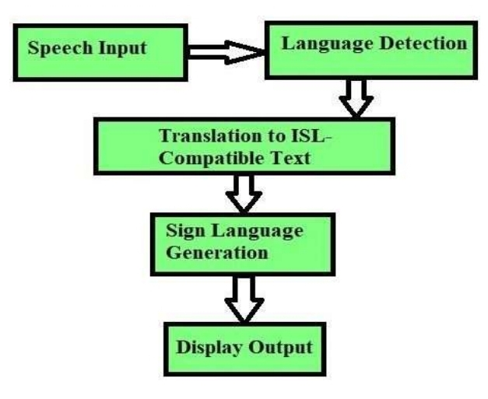
Architecture

Slide 12
Software components
Android Studio
Java
Google Speech Recognition
MyMemory Translation API
Glide – output displaying

Slide 13
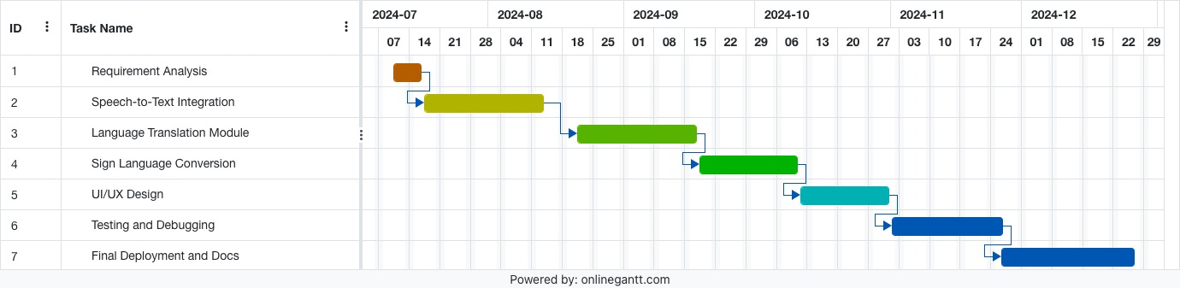
Timeline of Project

Slide 14
Outcomes
Efficient Text-to-Sign Language Translation :
The application successfully converts user-inputted text into sign language, providing an accessible means of communication for hearing-impaired individuals.
Multilingual Support :
The application supports multiple spoken languages, allowing users to choose their preferred language for translation.
Scalable Design:
The modular design of the app makes it scalable for adding new features, languages, and resources in the future.
Increased Accessibility :
The app promotes inclusivity by enabling communication for individuals with hearing impairments and raising awareness about sign language.
Integration with Third-Party Tools :
The use of the Glide library ensures efficient image loading and enhances the application's performance.
Platform for Further Research:
The project provides a baseline for exploring advanced features like animated sign gestures and natural language processing for contextual translation.

Slide 15
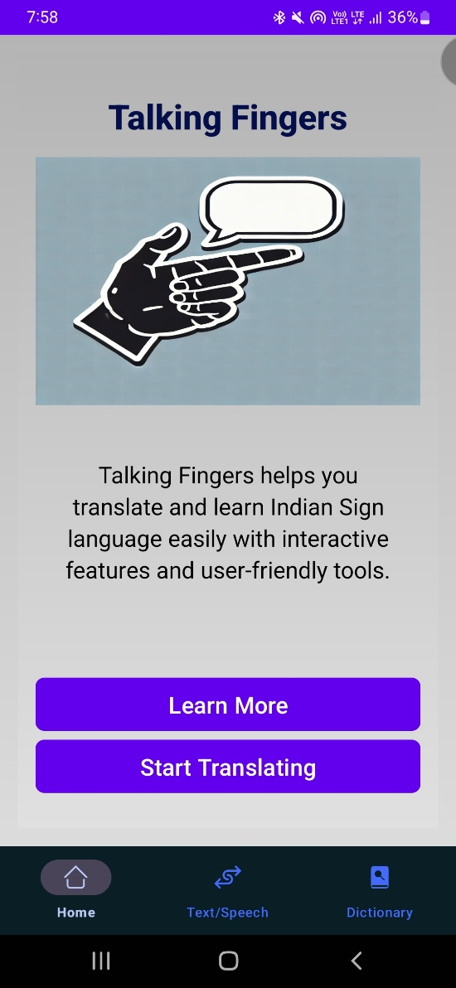
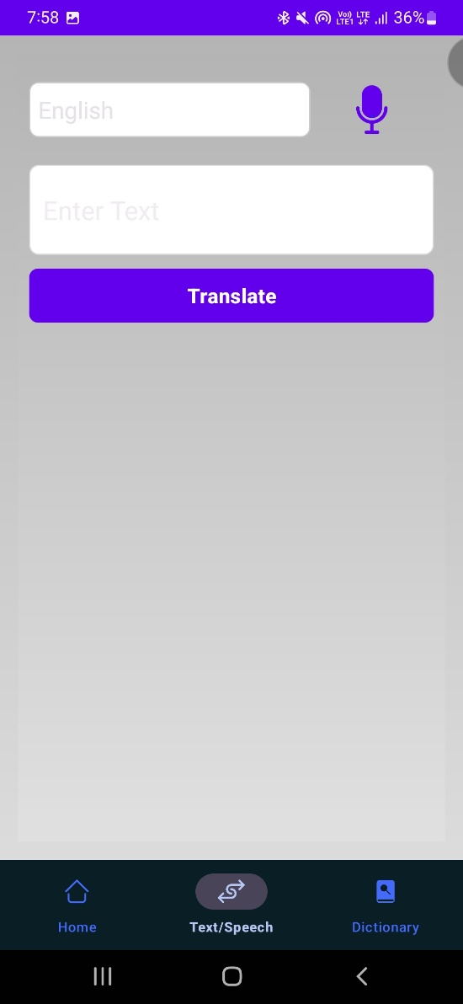
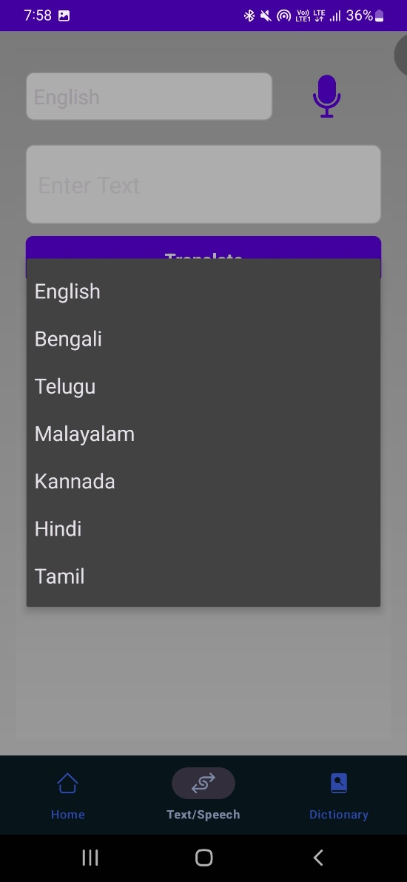
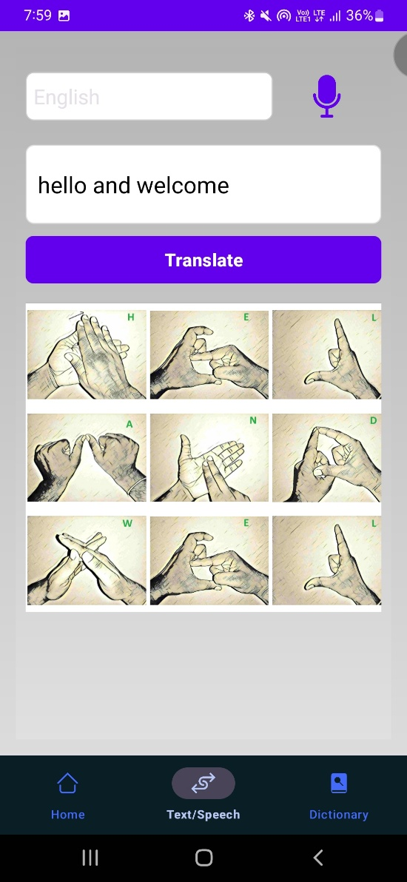
Outputs

Slide 16
Conclusion
Bridging Communication Gaps:
Talking Fingers enables seamless communication between hearing and hearing-impaired individuals.
Converts multilingual speech to Indian Sign Language (ISL) using advanced AI technologies.
Technological Innovation:
Utilizes speech recognition, NLP, and deep learning for real-time speech-to-sign language translation.
Displays sign language through a 3D avatar for better accessibility.
Inclusivity and Accessibility:
Promotes inclusivity by making communication easier for the hearing-impaired community.
Supports multilingual input, ensuring accessibility for users from diverse linguistic backgrounds.
Future Scope:
Expansion to support additional sign languages.
Improved accuracy and potential for offline capabilities to increase usability.

Slide 17
Github Link
Github Link
https://github.com/Anvith-G/TalkingFingers

Slide 18
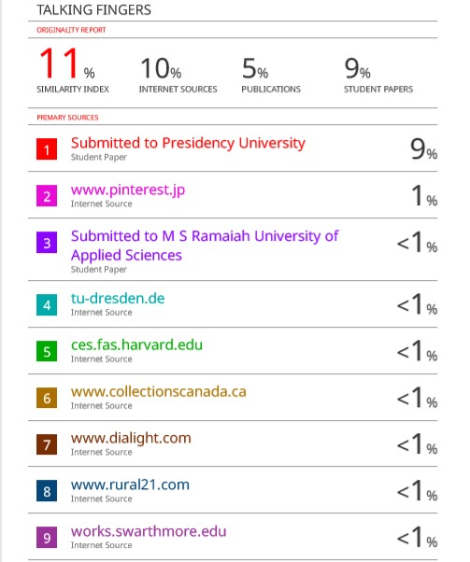
Similarity Check

Slide 19
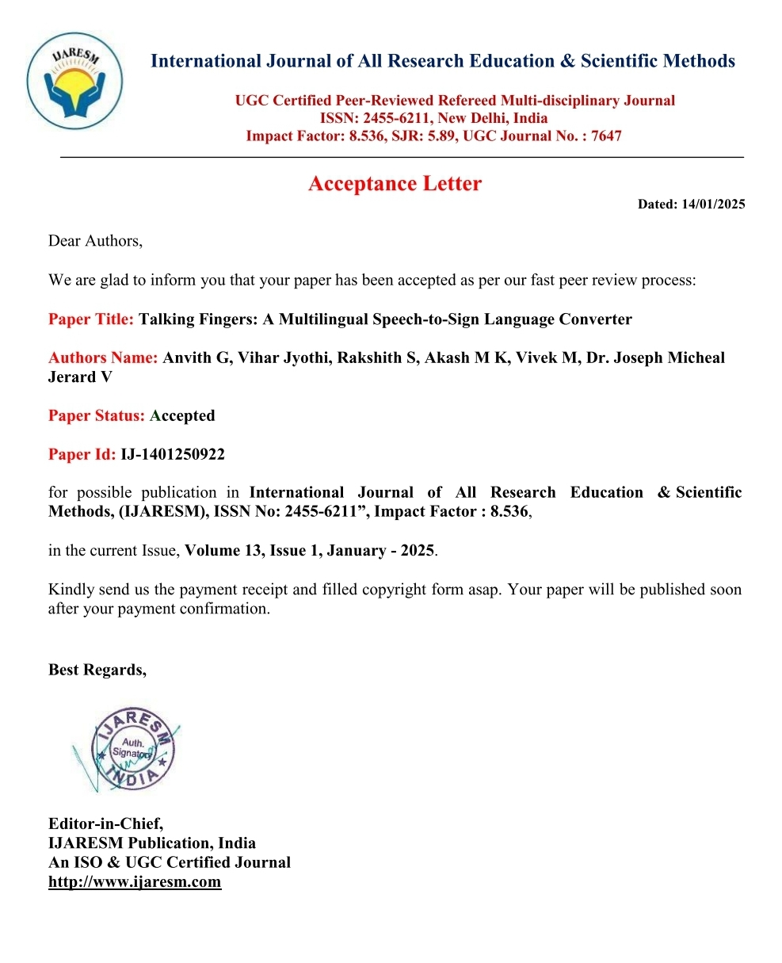
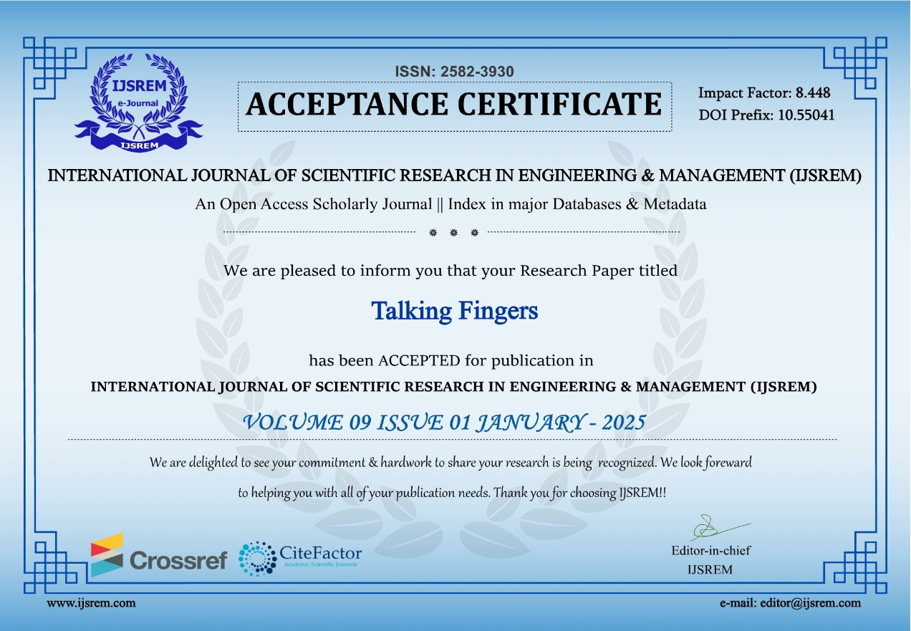
Publishing and Acceptance Letter

Slide 20
Project work mapping with SDG
1. SDG 4: Quality Education
Provides a platform for learning sign language, promoting inclusive education for students with hearing impairments.
Bridges communication gaps, enabling hearing-impaired individuals to better engage in educational activities.
2. SDG 8: Decent Work and Economic Growth
Enhances the employability of hearing-impaired individuals by improving their ability to communicate effectively in workplaces.
Supports businesses in adopting inclusive practices by fostering better communication between employees and customers with hearing impairments.
3. SDG 10: Reduced Inequalities
Reduces communication barriers for people with hearing impairments, enabling their participation in social, educational, and professional activities.
Encourages the normalization and acceptance of sign language as a mode of communication.

Slide 21
Contd.
SDG 11: Sustainable Cities and Communities
Enhances community engagement by enabling seamless communication between individuals with hearing impairments and the broader population.
Fosters inclusive environments in public spaces, schools, and workplaces.
SDG 9: Industry, Innovation, and Infrastructure
Leverages technology to create an innovative solution for accessibility challenges.
Sets the foundation for future advancements, such as real-time speech-to-sign translation and gesture animation.
SDG 17: Partnerships for the
Provides a platform for collaboration among developers, educators, and advocacy groups to expand sign language resources.
Encourages partnerships with NGOs and governmental organizations to scale the impact of the project.

Slide 22
References
https://thinkindiaquarterly.org/index.php/think-india/article/view/17330
http://ijsetr.com/uploads/456123IJSETR4094-107.pdf
https://iopscience.iop.org/article/10.1088/1757-899X/1105/1/012078/meta
https://ieeexplore.ieee.org/abstract/document/7975564
https://ieeexplore.ieee.org/abstract/document/10249995
https://eric.ed.gov/?id=ED419331

Slide 23
Thank You

